Slide 1

William Chen
Joseph Jaconetta
February 22, 2021 IST300

Slide 2
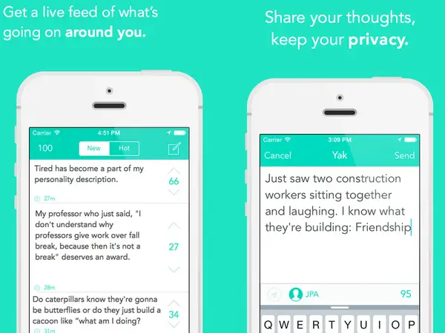
Why are we here?
Inform you about Sarahah
“helps you in discovering your strengths and areas for improvement by receiving honest feedback from your employees and your friends in a private manner."

Slide 3
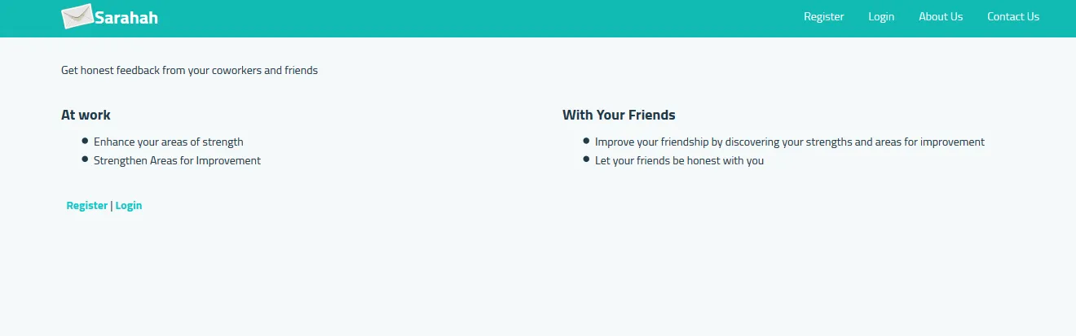
What makes Sarahah a platform?
Sarahah users
Honest and constructive feedback

Slide 4


What made it popular?
Anonymity
Snapchat, Facebook, Instagram
Launched on US app store on June 13, 2017
By July 17th, Sarahah became the app store’s most downloaded app

Slide 5
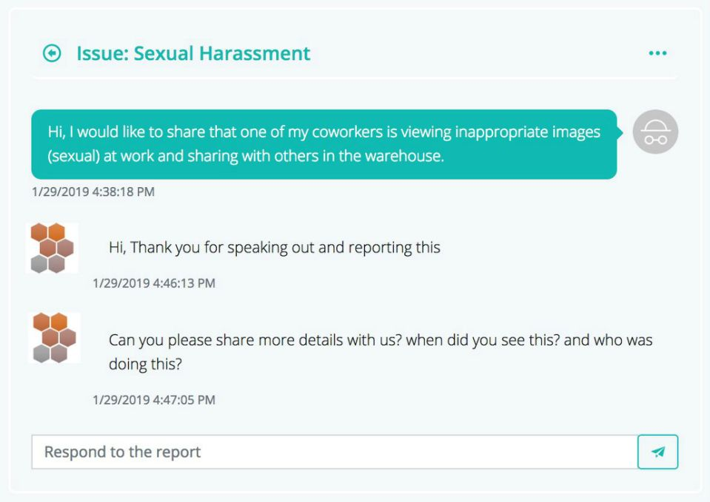
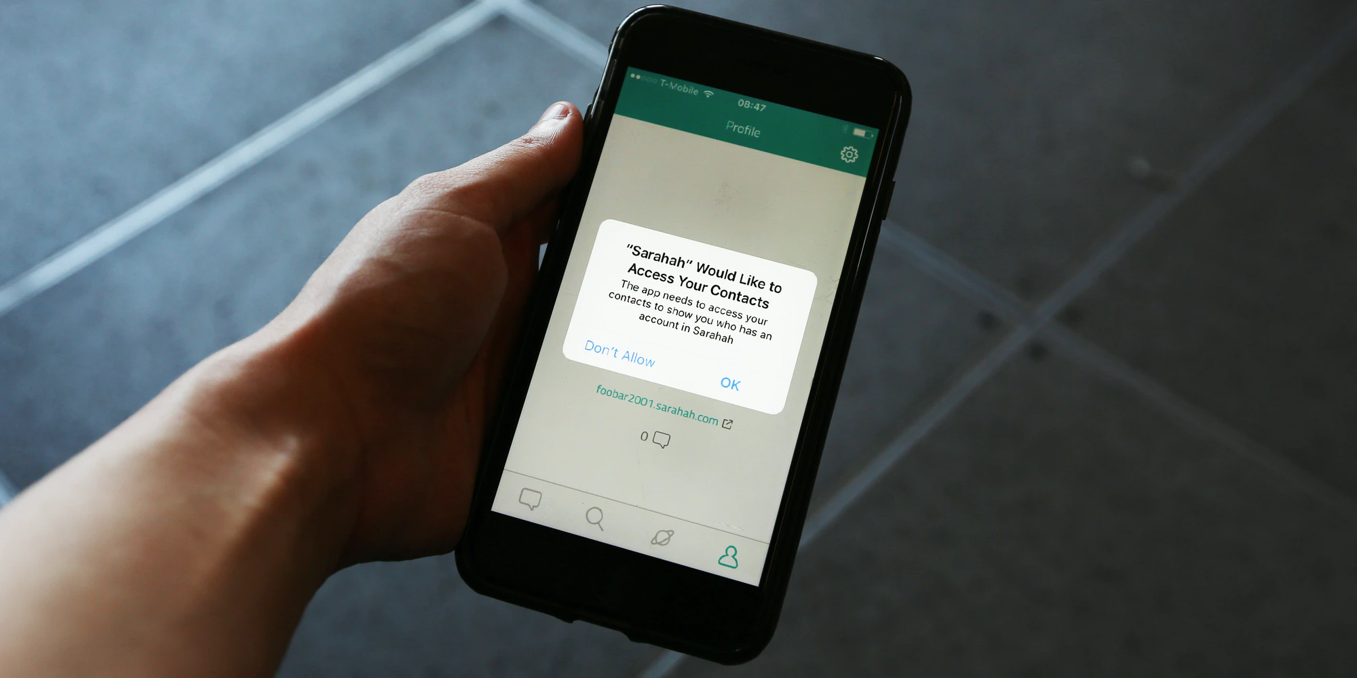
The Downfall - Why did it lose engagement?
Cyberbullying
Security problems
“What did you think was gonna happen if you let people text other people anonymously?”
-App Store Critic

Slide 6


What was its business model?
Word of mouth
Social media
Advertisements

Slide 7

Conclusion
Sarahah disappeared, made another platform called Enoff
Anonymous platforms are likely to fail
Any Questions?

Slide 8
References
Chittuluru, Sabareesh. “Sarahah - Time to Change Its Business Model?” Medium, Medium, 14 Oct. 2017, medium.com/@sabareesh25/sarahah-time-to-change-its-business-model-8404de9f7fb8.
“Controversial Messaging App Sarahah Returns to Google Play a Year after Being Banned.” Mobile Marketing Magazine, mobilemarketingmagazine.com/controversial-messaging-app-sarahah-returns-to-google-play-a-year-after-being-banned#:~:text=Sarahah%20describes%20itself%20as%20%E2%80%9Ca,suggesting%20she%20should%20kill%20herself.
Grauer, Yael. “Hit App Sarahah Quietly Uploads Your Address Book.” The Intercept, 27 Aug. 2017, theintercept.com/2017/08/27/hit-app-sarahah-quietly-uploads-your-address-book/.
Hartmans, Avery. “The Top Free App in the App Store Right Now Is Being Called 'a Breeding Ground for Hate'.” Business Insider, Business Insider, 18 July 2017, www.businessinsider.com/sarahah-app-store-bullying-harassment-2017-7.
Lunden, Ingrid. “After Bans from Apple and Google, Sarahah Debuts Enoff, an IOS App for Anonymous Feedback at Work.” TechCrunch, TechCrunch, 31 Jan. 2019, techcrunch.com/2019/01/31/after-bans-from-apple-and-google-sarahah-debuts-enoff-for-anonymous-feedback-at-work/.
Media, Common Sense. “What Parents Need To Know About Sarahah, The Anonymous Messaging App Sweeping The Globe.” HuffPost, HuffPost, 22 Aug. 2017, www.huffpost.com/entry/everything-you-need-to-know-about-sarahah-the-anonymous_b_599b51eee4b0ac90f2cba943.
Molina, Brett. “Sarahah: Four Things You Should Know about Popular App.” USA Today, Gannett Satellite Information Network, 9 Aug. 2017, www.usatoday.com/story/tech/talkingtech/2017/08/09/sarahah-four-things-you-should-know-popular-app/551679001/.
“One of the World's Most Controversial Apps Has Finally Been Banned.” The Independent, Independent Digital News and Media, 26 Feb. 2018, www.independent.co.uk/life-style/gadgets-and-tech/news/sarahah-banned-iphone-android-download-app-store-down-not-working-anonymous-curious-cat-a8228941.html.
“Sarahah Founder Says New Anonymous Messaging App Won't Devolve Into Toxicity.” Yahoo!, Yahoo!, www.yahoo.com/now/sarahah-founder-says-anonymous-messaging-170002503.html#:~:text=On%20its%20face%2C%20this%20new,we%20saw%20very%20diverse%20users.&text=He%20also%20noted%20that%20Sarahah,Apple's%20and%20Google's%20app%20stores.
“Sarahah.” Wikipedia, Wikimedia Foundation, 7 Jan. 2021, en.wikipedia.org/wiki/Sarahah.
“Sarahah: All You Need to Know about the App That's Spamming Your Social Media Feed.” The News Minute, 11 Aug. 2017, www.thenewsminute.com/article/sarahah-all-you-need-know-about-app-s-spamming-your-social-media-feed-66645.

